Slide 1

Object Systems
Methods for attaching data to objects, and connecting behaviors
Doug Church

Slide 2
Outline of Talk
Quick definitions
Progression of object data complexity
The problem in the abstract
Current approaches to this problem
Small Case Study
Problems, lessons, and tradeoffs

Slide 3
Why an “object system”
Games have more and more objects to track
Compared to years ago, these objects are
  more diverse (different types of data)
  more dynamic (data and fields change often)
  much larger
  support more emergent behaviors
Game object data has become a major part of our games, worth real analysis

Slide 4
A brief history of Objects
The goal of this section is to make clear the complexity of objects in some modern games.
We will examine a sequence of object models, from simplest up, looking at how they handle the data issues.

Slide 5
Hard-coded Constants
Objects simply have type and position
All behaviors are implied from this
A big static array of objects
No save/load or versioning
ex. Space Invaders like games

Slide 6
Simple object structures
~5 custom structure types (npc, weapon)
Each has a common beginning (location, id)
Each has custom fields (hp, damage, speed)
Often pre-sized static arrays for each type
Simple save/load w/o versioning
ex. basic RPG circa 1990

Slide 7
C++ hierarchy
Just use C++ inheritance as is
Objects are simply class objects
Derived classes add new fields
Binary rep not trivial to effectively version
  Though C++ makes serialize functions easier
This initially was just data, not code

Slide 8
Example: Space Invaders Like
All objects have same data
Type data used to control behavior
Your Ship, Enemy Ships, Bullets, UFO
Global state (remaining enemies, time) used to control enemy speed, animation
  Probably position too, really
Object
-Type
Position

Slide 9
Example: Tempest Like
More types of enemy ship, with more individualized/asynchronous behavior
More data to store per object
Object
-Type
Position
Speed
Animation

Slide 10
Example: Old School Tile RPG
Several game object types, some common data, but also type specific information
Many specific objects
Object
Type
Location
Creature
Goal
Motion
HP
Text
Treasure
Value
Gear
Worn At
Damage
Value

Slide 11
Example: More complex RPG
But how do I make
  a spiky tree that does damage?
  a sword that talks?
Object
Type
Location
Creature
Goal
Motion
HP
Text
Treasure
Value
Gear
Worn At
Damage
Value

Slide 12
Example: More dynamic RPG
What if I want some objects to be able to catch on fire, be poisoned, or make a sound when hit, or…
Do we just start moving all possibly necessary data up into the basic object?
This may sound like a few simple things, but a modern simulation has hundreds, if not more, potential data fields to track

Slide 13
If you don’t believe it can really get extremely complicated
Some Example Screenshots
(from the Thief Game Editor)
Object Browser
Specific Object
Property List
Property Editing on an Object

Slide 14
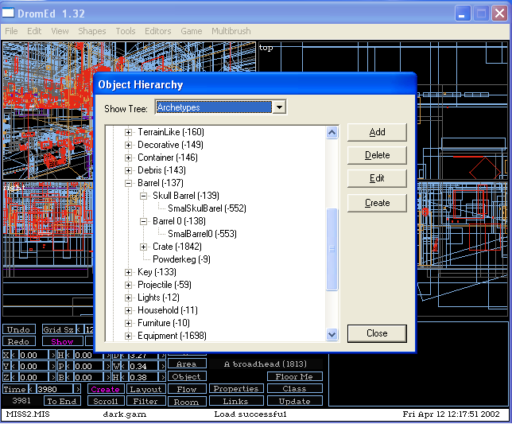
Object Browser

Slide 15
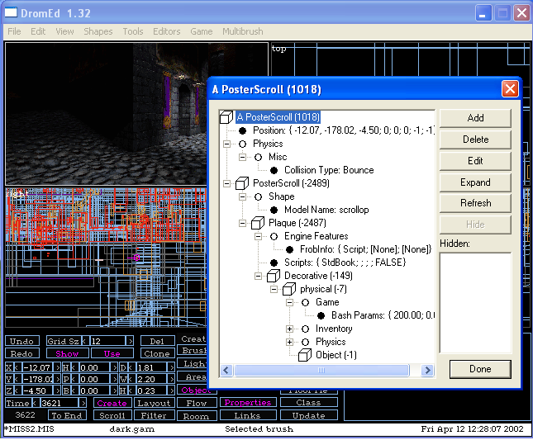
Specific Object

Slide 16
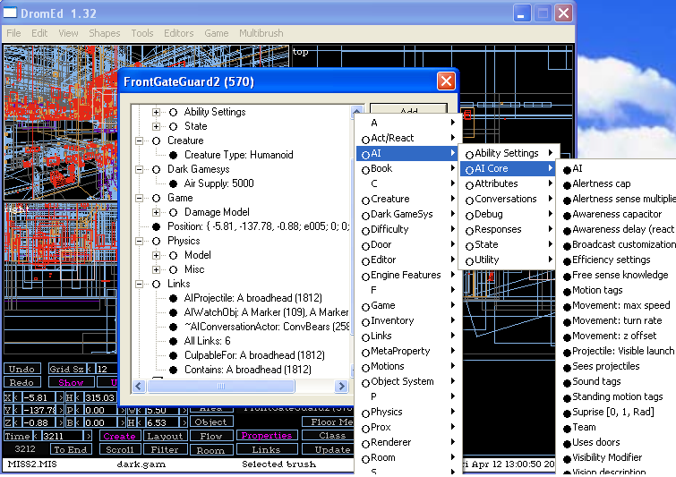
Property List

Slide 17
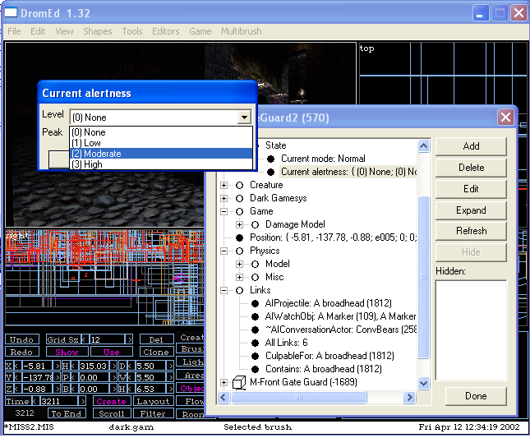
Property Editing on an Object

Slide 18
Lesson
As we get more complex, simple approaches break, data becomes more sparse and pushing it up the tree is very inefficient in terms of space, and it is hard to manage the data effectively
Picture trying to put all that data in the basic object… or dynamically resizing and repacking objects with inlined fields… or?

Slide 19
So what do we do about it?
Various cool approaches from “real software”
View it all as a relational data base
Build in introspection like capabilities
Attach code to objects for flexibility
Support varieties of storage forms
Inheritance and instantiation of aspects

Slide 20
What sorts of choices do we have
Is the data stored with objects or properties?
Major speed/space tradeoffs for retrieval
How does inheritance and overriding work
Where are the behaviors associated with the property? In scripts, in game code, in both?
How different are abstract and concrete objects?
How dynamic is the system? Can you create types at run-time? Change properties on abstracts?

Slide 21
Some approaches
Particular approaches from recently shipped games

Slide 22
Halo
Object-centric view
    Fixed size block (stored in an array)
      Position, velocity, and a pointer to the variable block
    Variable sized block (stored in a heap)
      Subsystem dependent properties (AI, physics models, effects)
Class hierarchy of types
    Shipped with 11 leaf classes
      “things would have been much easier if we’d specialized more”
Function evaluation system
    Jeep velocity → jeep brake lights to get “backup lights”
    Plasma rifle heat value → heat display meter

Slide 23
Thief
Property-centric view of the world
  Objects are just ID’s, and can have any property
  Of course, many have implicit rules of use and relationships
Programmers code property behaviors
  Publish property fields, value range, help message to edit tool
  Flexible implementations, allowing a speed/space choice
Scripting works with property system
  Scripts can be attached and inherited like other properties
  Script system can easily read/write property values
Links between objects
  Avoid out-of-date object reference bugs
  Ability to attach data to connections (timeouts, etc)
  Allow multiplicity… an object can care about lots of others at once
4000+ abstract objects, several thousand concrete objects

Slide 24
Dungeon Siege
Property-centric view
    Property hierarchy with single inheritance
    Components are compositions of properties
Highly integrated with scripting language
    Properties can be written in C++ or script language
    Properties can have scripts attached
Components in hierarchy
    Discouraged designers from dynamic component creation
      “I don’t want our designers mixing and matching types”
    Designers wanted lots of prefab types for authoring speed
      tree_waving, tree_bushy, etc.
    7500 leaf classes when shipped

Slide 25
Thief Property System Implementation Details
A Quick Case Study

Slide 26
Major goals
Allow systems to quickly iterate over the data and objects they care about, don’t force indirections
Programmer chooses what cases to optimize for, but system automatically supports all cases
Maximize designer flexibility and control
Allow scripting, but don’t depend on it
A property should be implemented with as little impact on other systems as possible
Most properties are sparse, so creating and adding properties must be a light weight decision

Slide 27
Coding with the system
Object’s are only an ID
One references a property by GUID (which you can get by asking the Property Manager for a GUID for a given name)
  IProperty *pProp = GetProperty(“HitPoints”)
Given a property, ID gets the data
  int hp = pProp->GetIntProperty(ID)
Cannot change the data in place, need to call Set
For Structures, pass reference to pointer you want

Slide 28
Property Implementation
A collection of data storage models are pre-built, instantiate the template for your type
  Array’s, individual hash, shared hash, bitfields
Define the fields of the property by name
Can deal with properties in two ways
  Given an object, query about the property
  Iterate over all objects with the property
Which data store you use depends on your primary usage case, and how often you reference it
All of this property code is very localized

Slide 29
Example: Physics
Physics needs fast random data access about all physics objects while in physics loop
Physics keeps a linear array of data
  Array has all physics information + Object ID
  Supplementary hash connects ID -> array
Physics loop, therefore, just operates on its own array
  No indirections or overhead, just use the array information
  Can use the ObjID to get the values of any other properties
Other systems which need physics data go through GetProperty, which internally calls the physics storage model, hashes the ID, and returns array data for that object

Slide 30
Sadly
The object tree is big, so object based property lookups end up being relatively slow
This is because many property retrievals require a traversal of the entire tree
So we need to reduce the tree searches
When we find a property value, cache it at the lowest abstract level of the tree
Future lookups will find the cached version
Note: Need careful coding to make sure that cache invalidation works right when tree changes

Slide 31
Designer Usage
Programmers expose a name and valid data ranges for each field of each property
Designers can place properties on (and links between) objects, and change attached data
Designers create and maintain the object hierarchy, decide how to define the world
Can create simple (int) properties by name

Slide 32
Specific Object (again)

Slide 33
Major Issues
Object creation time too long
  Have to ask each property what it wants to do
  (machine gun bullets in Combat Flight Sim)
Programmer Complexity… to meaningfully use the system, steep learning curve
Tools were not robust until the middle of the development
  So we missed chances to do things right earlier
  Lots of code from earlier “unfinished” period shipped
Property systems underlie the game, so changes to them impact large sections of the code
  The system allows easy change to property code
  But changes to the system itself are not so easy

Slide 34
Problem Example #1
Hierarchy, inherited value, local override
  What happens when global value changed
  Several subtle issues, for instance:
    If a local property has same value as global, do you save it out, or do you auto-delete it as it is redundant
    Of course, if you remove it, and the global changes, then you lose the original set value
    Probably want the local to remain itself even when shadowed by the same global setting

Slide 35
Problem Example #2
Failed queries can take a lot of time
  Determining a property is missing requires a full search up the tree
  Successful lookups are stored in cache
  To deal with failure problem, they must be too
This fixes the speed problem
  But requires extra cache space and complexity

Slide 36
Typical Object System Design Frustrations
Object creation time can get very large
Need tools which show why a given property value is on a given object
  Esp. when debugging the system itself
Your designers will use the system… be prepared for very “creative” usage
Educating the team is vital! Designers and programmers both must “get it”

